Slide 1
File in Linux
Tin hoc Nhã uyên 10/2018

Slide 2
Content
Overview File in Linux
File I/O basic method
File I/O atomic and race condition
File control operation
Relationship between File Descriptor and Open File
File I/O some advance method
File buffering and stdio library buffering

Slide 3
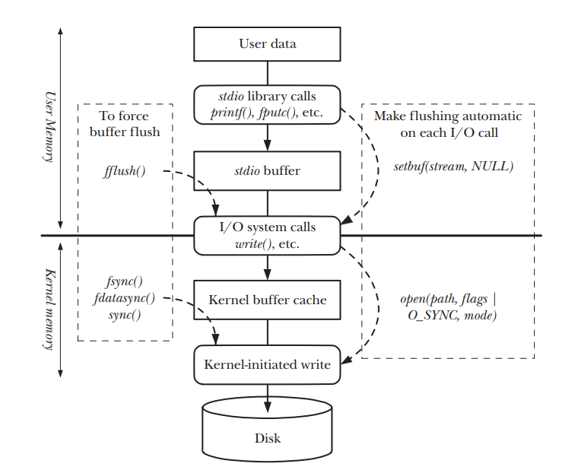
Overview File in Linux

Slide 4
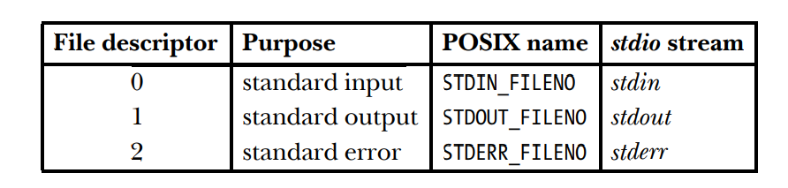
File I/O - Overview
File is central to the UNIX philosophy
All system calls for performing I/O referring to a file descriptor
Is nonnegative integer, start from 0
File descriptor are used to refer to all types of file, pipe, FIFOs, socket, terminals, devices
Each process has it own set of file descriptor
Most of program expect to able to use three standard file descriptor
Running process inherit copies of the shell opened file descriptors
4 key system calls for performing file IO
fd = open(pathname, flags, mode)
numread = read(fd, buffer, count)
numwritten = write(fd, buffer, count)
status = close(fd)

Slide 5
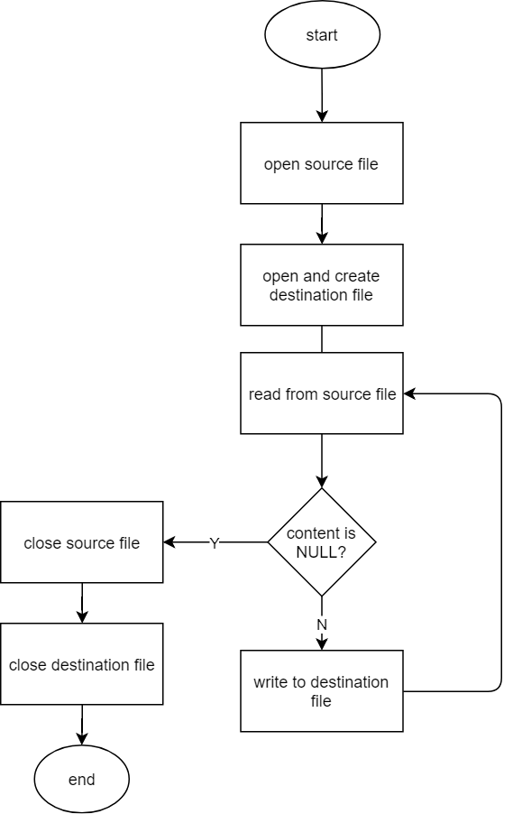
File I/O – basic method- file copy example

Slide 6
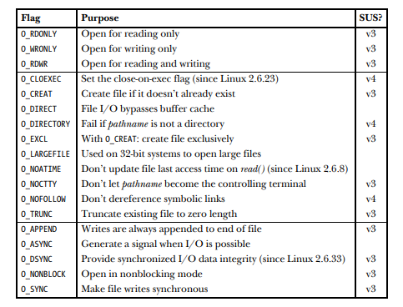
File I/O – open
Three group of flags
File access mode flags
Read only, Write only and Read-Write
Can retrieve by fcntl F_GETFL
File Creation flags
Open file status flags
Can retrieve and modified by fcntl F_GETFL
Return file descriptor
Lowest number available
int open(const char *pathname, int flags, ... /* mode_t mode */);

Slide 7
File I/O – open (2)
Important flags
O_APPEND
Write always append end of file
O_ASYNC
Signal-driven IO, but in Linux this flag no effect, in order to enable this feature, use fcntl flags
O_CLOEXEC
Close the file when calling exec family function
O_CREATE
If file is not exist, file is created
O_DIRECT
Allow File IO to bypass the buffer cache
O_EXCL
Conjunction with O_CREATE to indicate that if the file exist, it should not be opened, open fail, errno set to EEXIST
O_NONBLOCK
Open file for non-blocking
O_SYNC
Open file for synchronous I/O
O_TRUNC
If file exist, the content of file is discard and length is truncated to zero

Slide 8
File I/O – open (3)
Error from open – strerror(errno)
EACCES
File permission don’t allow the calling process to open the file in mode specified by flags
Directory permission don’t allow file created or writing
EISDIR
File in pathname is directory and open file for writing
EMFILE
The process resource limit on the number of open file descriptor has been reached
ENFILE
System resource limit on the number of open file descriptor has been reached
ENOENT
File is not exist and O_CREATE is not specified
EROFS
File is read-only but open is for writing
ETXTBSY
File is an executable file and it is currently executing. It is not allow to modify a executable file that is running as a process

Slide 9
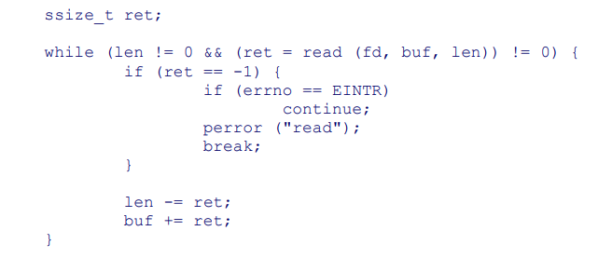
File I/O - read
Arguments
Count specifics the maximum number of bytes to read,
Buffer is where data placed, the buffer must be at least count bytes long
Return value
Return number of bytes actually read
Number of byte read is less than count because some reason
Interrupt by signal return with errno EINTR
New line
0 with end of file (EOF), nothing to read
-1 with error – use strerror(ret) to know what error
ssize_t read(int fd, void *buffer, size_t count);

Slide 10
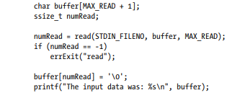
File I/O – read (2)
Blocking mode
Read default in blocking mode except regular file
Append zero to end of buffer explicitly
Data can be text, binary interger, C structures in binary form → read don’t know what type data comming
Buffer length must be at least one greater than largest string we expect
Non blocking mode
Read return immediately with errno set to EAGAIN

Slide 11
File I/O -write
Argument
Count is number of bytes write to file descriptor
Buffer store the content
Return value
Return number of bytes that actually write, this value can be less than count
For regular file, a success return from write doesn’t guarantee that data has been transfer to disk due to kernel perform buffering of disk I/O to reduce disk activity
ssize_t write(int fd, void *buffer, size_t count)

Slide 12
File I/O - close
Free file resource for reuse
If process terminate, all descriptor close automatically
int close (int fd);

Slide 13
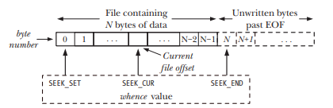

File I/O – change file offset - lseek
File as sequence of bytes, kernel record file offset
File offset is set to point to the start of file when the file opened
Automatically adjusted by call read or write
Lseek adjust the file offset of open file
Argument whence
SEEK_CUR
Offset bytes from the beginning of the file
SEEK_END
Offset bytes from the current file offset
SEEK_SET
The file offset is set to size of the file plus offset → next byte after last byte of file
File hole
off_t lseek (int fd, off_t offset, int whence)

Slide 14
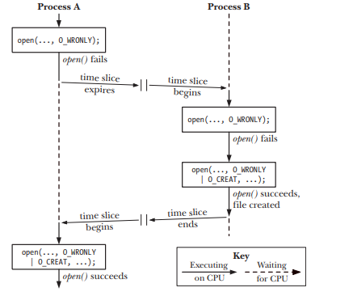
File I/O – Atomic and Race Conditions
All system call are executed atomically
Kernel guarantees that all of the steps in a system call are completed as a single operation without interrupted from other process or threads
Atomic is essential to the successful completion of some operations
Atomic allow avoid race conditions
A situation where the result produced by two processes operate on one shared resources in unexpected way on the relative order in which process gain CPU

Slide 15

File I/O – Appending data to a file
Multi-process appending data to the same file to write file
One process seek to end of file
Kernel stop process and allow other running
Other process seek to end of file
Other process write to end of file
Kernel stop other process and allow first process running
First process write to end of file but it replace content of other process
Avoid with O_APPEND

Slide 16

File I/O –File control operation
Control everything relate to file
Duplicate file descriptor
File descriptor flags
File status flags
File locking
IO availability signal
File change notification

Slide 17
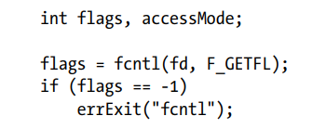


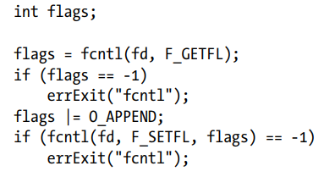
FILE I/O – File status flags
fcntl
Retieve or modify the access mode and open file status flags
F_GETFL command
F_SETFL command
Modify O_APPEND, O_NONBLOCK, O_NOATIME, O_ASYNC, O_DIRECT

Slide 18
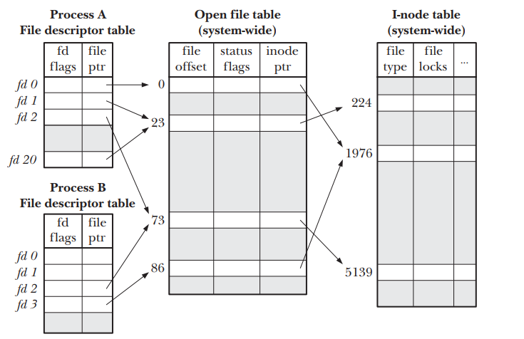
File I/O – Relationship between File Descriptor and Open File
Three data structures that maintain by kernel
Per-process file descriptor
set of flags controlling the operation of the file descriptor (close on exec)
The system wide table of open file descriptor
the current file offset
status flags specified when opening the file
O_APPEND, O_NONBLOCK, O_ASYNC
the file access mode(readonly, writeonly or read write)
settings relating to signal-driven I/O
a reference to the i-node object
File system inode table
file type (e.g., regular file, socket, or FIFO) and permissions
a pointer to a list of locks held on this file
various properties of the file, including its size and timestamps

Slide 19



File I/O – Duplicate file descriptor
I/O redirection
Standard error redirected to the same place with standard output
Sent both standard output and standard error to results.log
dup
Take an open file descriptor and return a new descriptor that refer to the same open file descriptor
dup2
Make a duplicate of file descriptor old to new
If newfd is opened, it closed

Slide 20
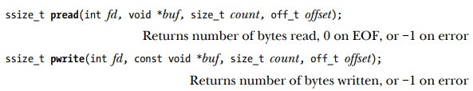
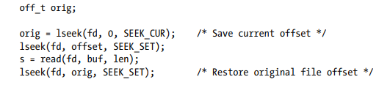
File I/O at specified Offset
Pread and pwrite
Operate like read and write
The file IO is performed at location specificed by offset than current file offset
The file offset left unchanged
Call pread equivalent call lseek + read but atomically
These function is useful in multithread applications
All open file descriptor shared by all threads
File offset of each file is global to all threads
Avoid race condition when read and write simultaneously

Slide 21
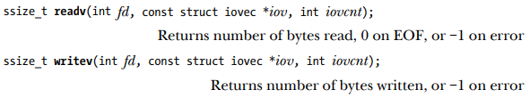

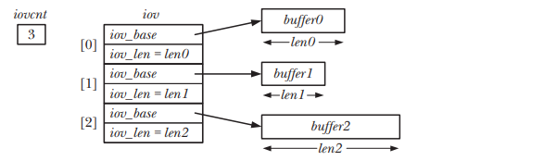
File I/O – scatter/gather IO
Scatter/Gather IO
Transfer multiple buffer of data in single system call
Set of buffers to be transferred is defined by the array iov
Scatter input
readv perform scatter input
read a contiguous sequence of bytes from the file descriptor to buffer’s iovec
readv is atomically → when reading from a file, the range of byte in iov’s buffer is continuous even if another process sharing the same file offset attempts to manipulate the offset at the same time
Readv return number of byte read or 0 if end-of-file was encountered
If insufficient data, some of last is partially filled

Slide 22
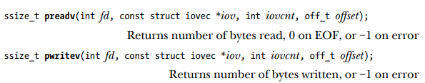
File I/O – scatter/gather IO (2)
Gather output
Writev system call perform gather output
Write as sequence of continuous bytes
Buffer gather in array order
Writev is atomically → all requested data is written continuously to the file
Like write, writev can return patially write.Let check the result to indicate
Readv and writev is convenience and speed
Writev can implement as copy of user buffers and call write
Call write multiple time but two way inconvenience and slow
Performing scatter-gather I/O at a specified offset

Slide 23

FILE I/O – truncating the file
Resize the file length
If file length is longer than length, excess data is lost
If file length is shorter than length, file will padding with sequence of null byte
The command use to discard the content of file

Slide 24

File I/O- creating temporary file
Create temporary file when program is running
Create a file in /tmp directory and return file descriptor
Template argument takes the form of a pathname in which the last 6 characters must be XXXXXX
6 XXXXXX wil be replaced with a string that makes the filename unique
Templace is modified → it must be specified as a character array rather than string constant

Slide 25


Kernel Buffering of File I/O
Working with disk
Read/Write system call don’t directly initiate disk access
They copy data between a user-space buffer and a buffer in kernel buffer cache
Write(fd, “abc”, 3)
Write return immediately
Some later point, kernel writes its buffer to disk
System call is not synchronized with disk
If another process attempts to read these bytes of file, the kernel supplies data from buffer cache
Read(fd, buf, 3)
Kernel read data from the buffer until is exhausted , kernel reads next segment of the file into the buffer cache
This design is allow read and write to be fast, process don’t need to wait on slow disk, and reduce the number of disk transfer that kernel perform
Two way to control kernel buffer of File I/O
Use system call
Use O_SYNC when open file

Slide 26
stdio library – standard IO
File streams
Standard IO
Relationship between stdio and File IO

Slide 27
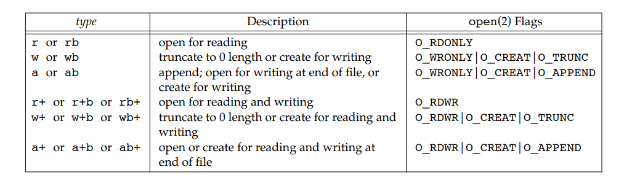
stdio library – API – open the file
FILE * fopen (const char *filename, const char *opentype)

Slide 28
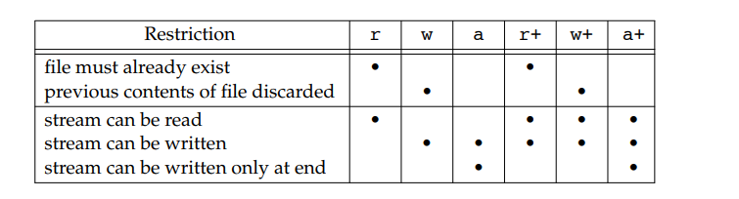

Slide 29
stdio library – API – close the file
int fclose (FILE *stream)

Slide 30

stdio library – API – read/write the file
fread (void *data, size_t size, size_t count, FILE *stream)

Slide 31
stdio library – API – file positioning
long int ftell (FILE *stream)
int fseek (FILE *stream, long int offset, int whence)

Slide 32

Buffering in the stdio library
Buffering of data into large block
Reduce system call and overhead
Increase performance when operate on disk
Settting the buffering mode of stdio stream
If buf is NULL, library automatically allocates a buffer for use with stream at least BUFSIZ 512 byte
Mode
_IONBF Don’t buffer IO, call system call read/write immediately, buf and size is irgnored
_IOLBF Line buffer, data is buffer until a newline character is output, for input, data is read a line at a time
_IOFBF Fully buffer I/O is default mode
Flushing a stdio buffer

Slide 33
stdio library – API -bufferring
Performance reason
Set buffer for buffering
Atleast BUFSIZ – 512 bytes
Set NULL to disable buffering
void setbuf(FILE *restrict fp, char *restrict buf );

Slide 34
Review
Program structure
Log
Error code
strerror
Shell tool
strace
fallocate -l 100M /tmp/bigfile
time
stat
grep

